Slide 1
Binary Trees
Chapter 11
Notes:
1

Slide 2
Chapter Contents
Introduction
Implementing Binary Search Trees
Binary Search Tree Traversal Algorithms
Binary Search Trees Building Algorithms
Binary Search Trees Applications

Slide 3
Objectives
Review tree terminology
Learn about binary trees
Explore different types of binary trees including binary search trees

Slide 4
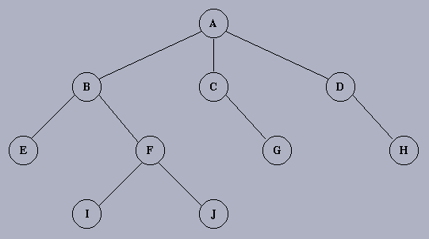
Trees
A tree is a nonlinear , two-dimensional data structure
A tree consists of nodes and branches

Slide 5
Trees
A tree structure is characterized as a set of nodes that originates from a unique starting node called the root
Node A is the root node

Slide 6
Trees Terminology
A node may be considered a parent of 0, 1, 2, or more children nodes
Node B is the parent node of nodes E and F
Node J is a child node of node F

Slide 7
Trees Terminology
A node with 0 children is called a leaf node
Nodes E, G, H, I, and J are leaf nodes

Slide 8
Trees Terminology
The children of a node and children of these children are called descendants
The descendants of node B are nodes E, F, I, and J

Slide 9
Trees Terminology
The parents and grandparents of a node are called its ancestors
The ancestors of node F are nodes B and A

Slide 10
Trees Terminology
Each node in a tree is the root of a subtree
A subtree is defined by the node and all descendants of the node
Node F is the root of the subtree containing nodes F, I, and J
Node B is the root of the subtree containing nodes B, E, F, I, and J
Node G is the root of the subtree containing only node G

Slide 11
Trees Terminology
We move from a parent node to its child and other descendants along a path
The length of a path is the number of edges on the path
The path from node A to node J consists of the moves: A to B, B to F, and F to J

Slide 12
Trees Terminology
The level of a node is the length of the path from the root to the node
Node A (the root node) has level 0
Nodes B, C, and D are of level 1
Nodes E, F, G, and H are of level 2
Nodes I and J are of level 3

Slide 13
Trees Terminology
The depth of a tree is the maximum level of any node in the tree
The tree is this example is of depth 3

Slide 14
Binary Trees
A binary tree, T, is either empty or such that
T has a special node called the root node
T has two sets of nodes, L_{T} and R_{T}, called the left subtree and right subtree of T, respectively
L_{T} and R_{T} are binary trees

Slide 15
Binary Trees
A restricted class of trees
Each parent node has no more than two children
Have a uniform structure that allows efficient scanning and efficient access to elements

Slide 16
Binary Trees
Each node has 0, 1, or 2 children
The node on the left is called the left child while the node on the right is referred to as the right child
Each node is the root of a subtree (left and right subtrees)

Slide 17
Binary Trees
Can be shown pictorially
Parent, left child, right child
Node represented as a circle
Circle labeled by the node
Directed edges (directed branches)

Slide 18
Drawing Binary Trees
Root node is drawn at the top
Left child of the root node (if any) is drawn below and to the left of the root node
Right child of the root node (if any) is drawn below and to the right of the root node

Slide 19
Binary Trees: Examples

Slide 20
Binary Trees
At any level n, a binary tree contain from 1 to 2^{n} nodes
The density of a tree is a measure of the size of a tree (number of nodes) relative to the depth of the tree

Slide 21
Binary Trees
Dense trees are good because they allow the storage of a large collection of data and maintain efficient access to the data (due to the shorter paths)

Slide 22
Min and Max Depth
The maximum depth in a tree with N nodes is k = N-1
The minimum depth in a tree with N nodes is k = log₂(N)

Slide 23
Types of Binary Trees
Complete Binary Trees
Full Binary Trees
Height-Balanced (AVL) Trees
Binary Search Trees

Slide 24
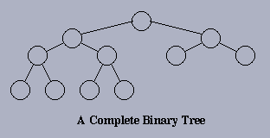
Complete Binary Trees
A complete binary tree of depth N is a binary tree in which each level 0 to N-1 has a full set of nodes and all leaf nodes at level N occupy the leftmost positions in the tree
The number of nodes N in a complete binary tree satisfies 2^{k} <= N < 2^{k+1}

Slide 25
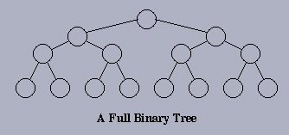
Full Binary Trees
A full binary tree is a binary tree in which every none-leaf node has two children
A full binary tree contains 2^{N} nodes at each level N
The number of nodes N in a full binary tree is N = 2^{k+1} - 1

Slide 26
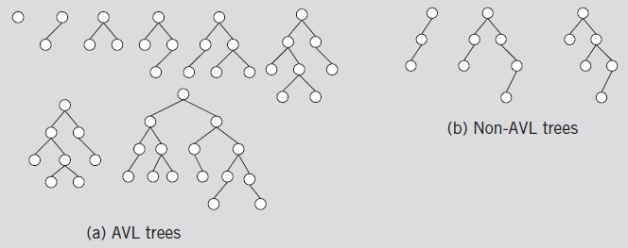
Height-Balanced (AVL)Trees
A height-balanced tree (or an AVL tree) is a binary search tree such that
The heights of the left and right subtrees of the root differ by at most one
The left and right subtrees of the root are AVL trees

Slide 27
Height-Balanced (AVL)Trees
AVL tree:
Resulting binary search is nearly balanced
Perfectly balanced binary tree
Heights of left and right subtrees of the root: equal
Left and right subtrees of the root are perfectly balanced binary trees

Slide 28
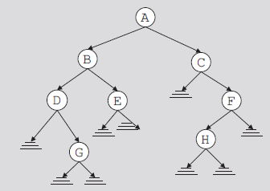
Binary Search Trees
Data in each node of a binary search tree is
Larger than the data in its left child
Smaller than the data in its right child

Slide 29
General Binary Trees vs. Binary Search Trees

Slide 30
Binary Search Trees
A binary search tree, T, is either empty or the following is true:
T has a special node called the root node
T has two sets of nodes, L_{T} and R_{T} , called the left subtree and right subtree of T, respectively
The key in the root node is larger than every key in the left subtree and smaller than every key in the right subtree
L_{T} and R_{T} are binary search trees

Slide 31
Building Binary Search Trees

Slide 32
Section 1- End

